Slide 1
Build your own Radar system Final presentation
BESSON Thomas - EZECHUKWU Dismas - WRIGHT Gilles
Group 3

Slide 2
Outline
Electronic circuit implementation
Voltage regulator
Modulator
Video amplifier
CW Doppler Radar
FMCW Doppler Radar
Improvements
Realtime
FMCW Improvements
SAR
SDR : CW
SDR : CW IQ Demodulation
SDR : SFCW

Slide 3
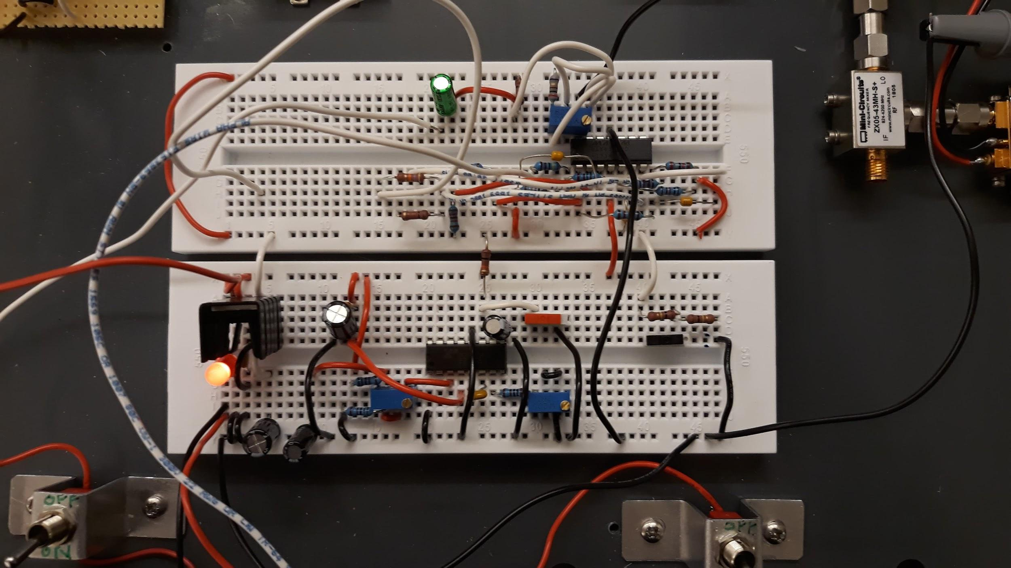
Hardware Implementation
Video Amplifier
-> Problem of stability
Use a bridge divider
Voltage Regulator
Modulator

Slide 4
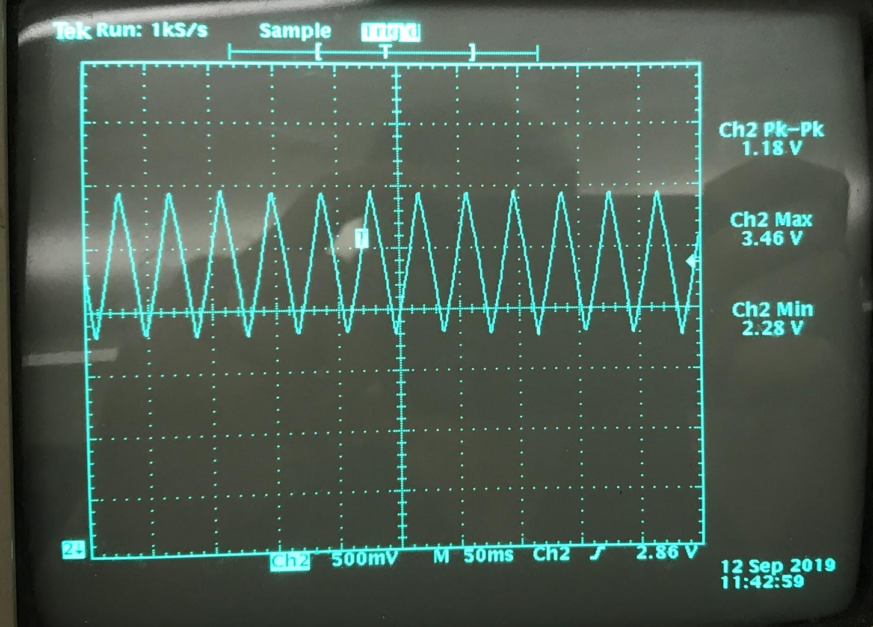
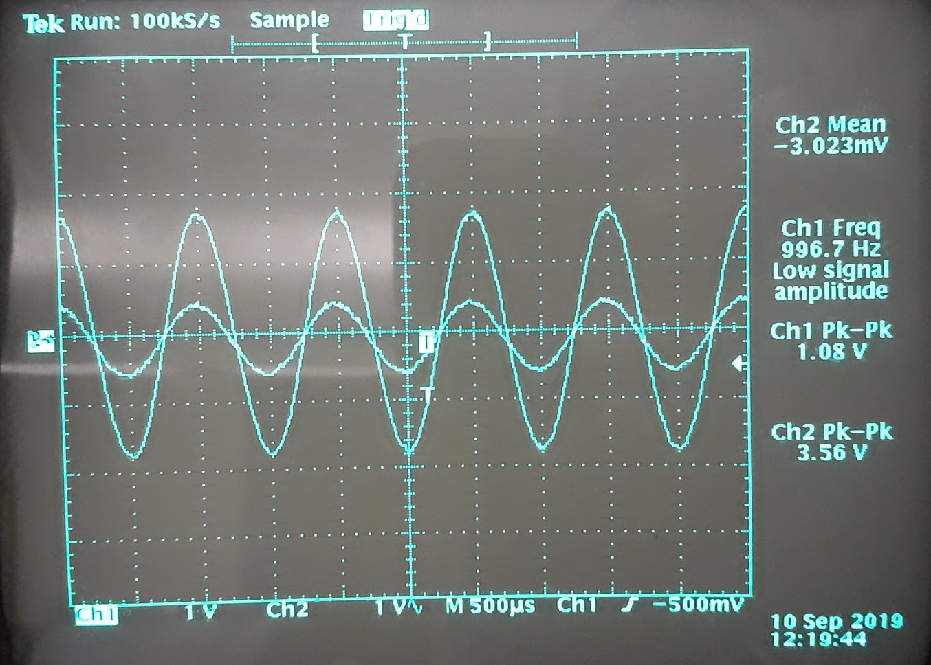
Measurements
Modulator
Period T = 40ms
Amplitude : between 2.28 and 3.46 => 1.18V pic-to-pic
Video amplifier
Linear gain ~ 4
Bandwidth : 13 kHz

Slide 5
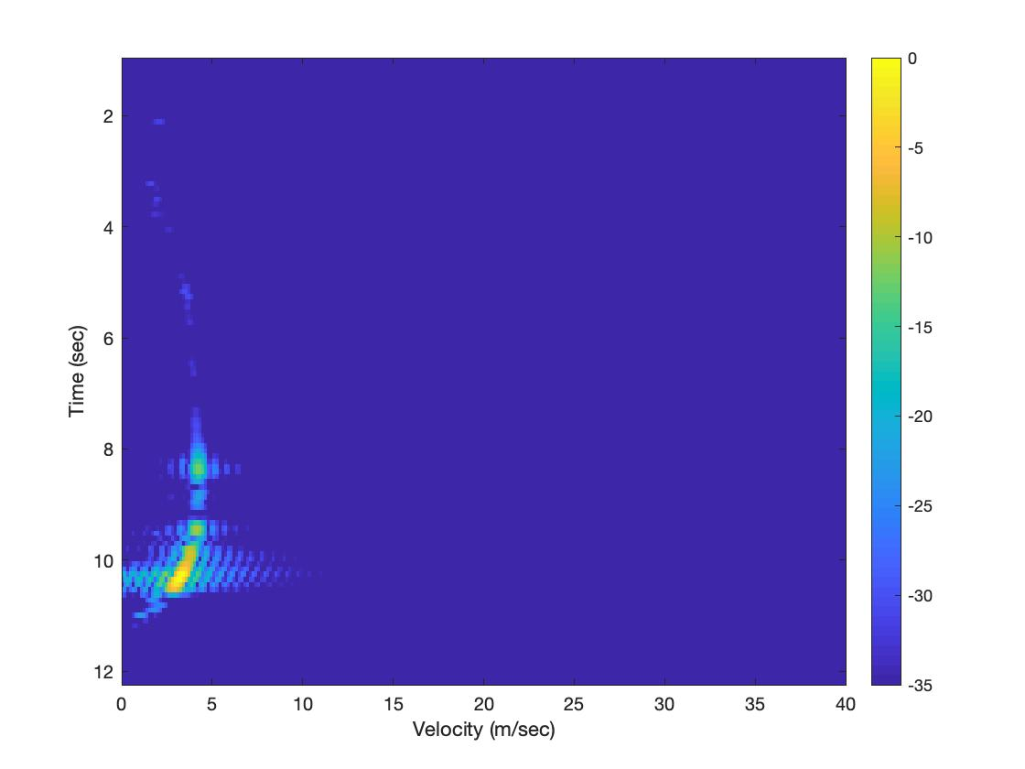
CW measurements - Single target
1 person running toward the radar
Range ~ 15m

Slide 6
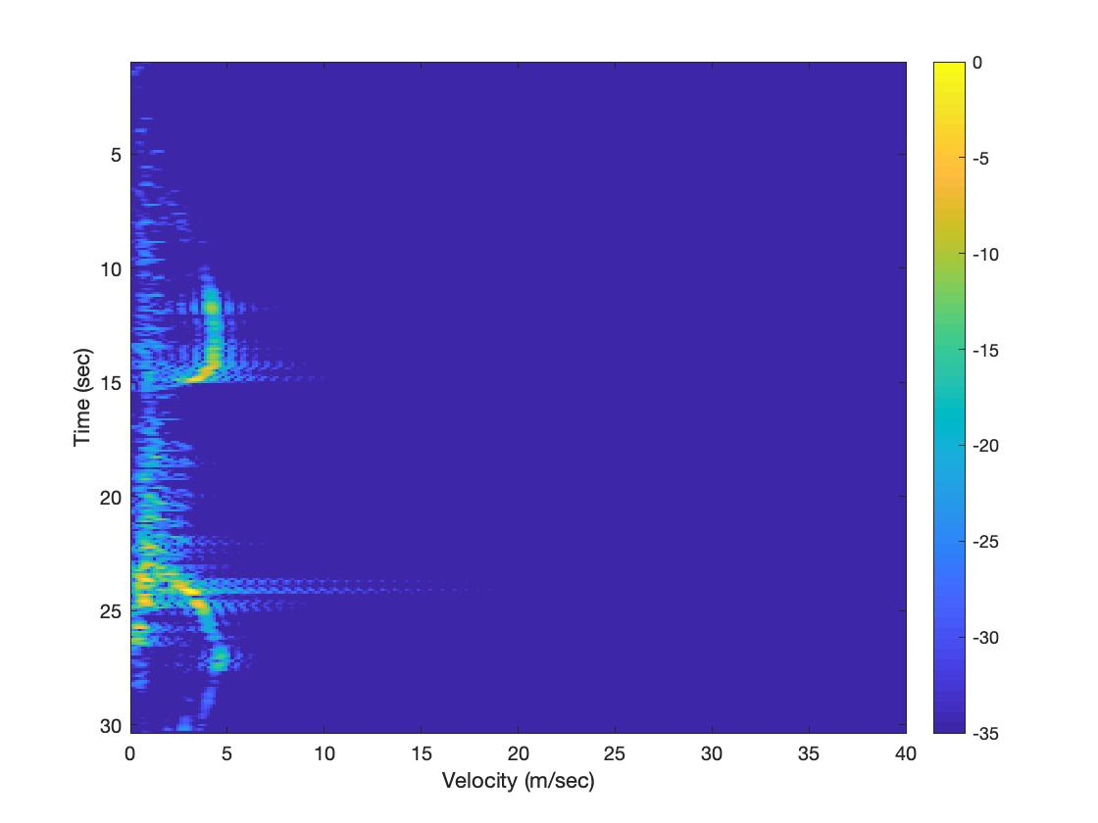
CW measurements - Multiple target
1 person on a scooter coming to / going away from the radar
1 person walking toward the radar

Slide 7
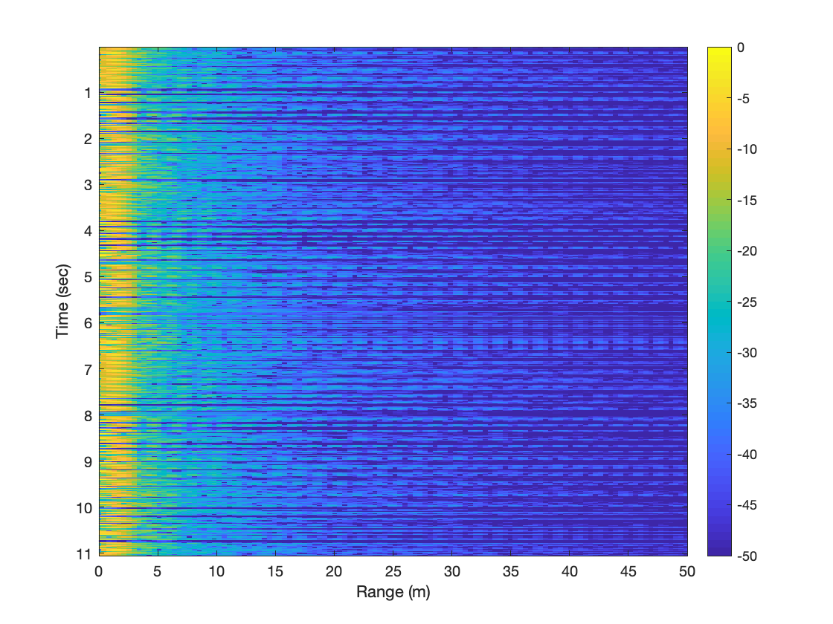
FMCW
Problem of wire :
-> Sync signal on the data wire

Slide 8
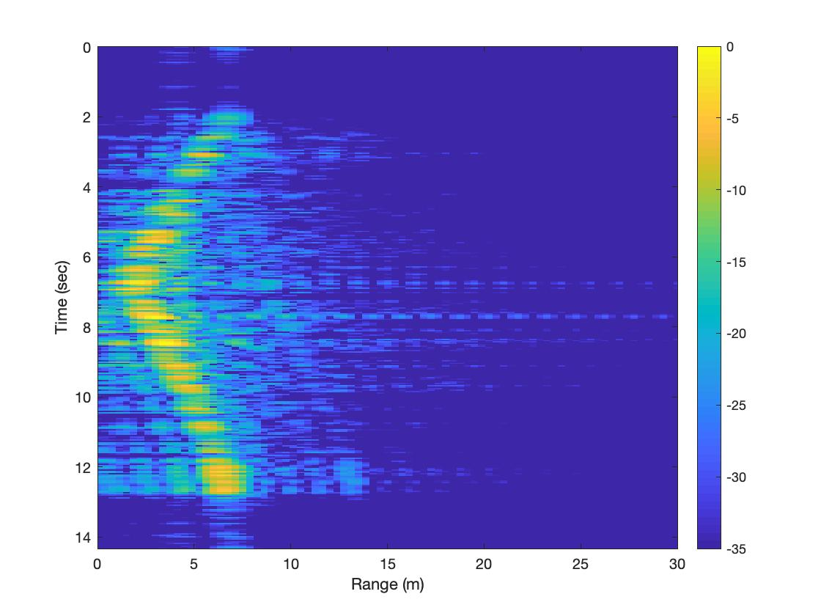
FMCW measurements - Single Target
1 person walking to / away from the radar

Slide 9
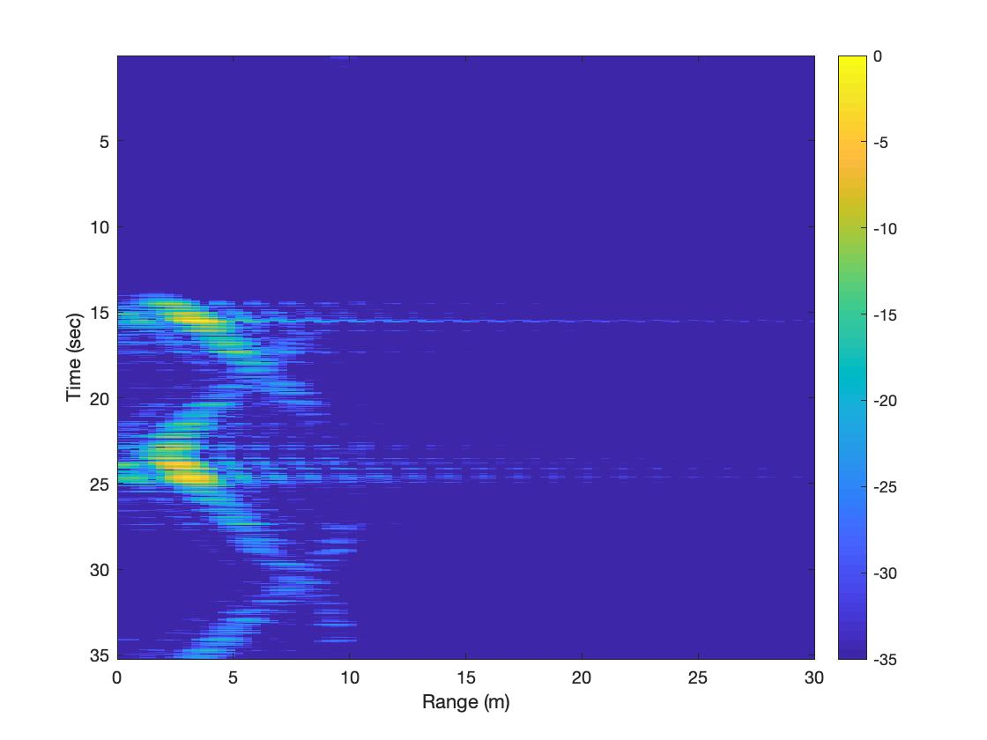
FMCW measurements - Multiple Target
2 persons walking in opposite directions

Slide 10
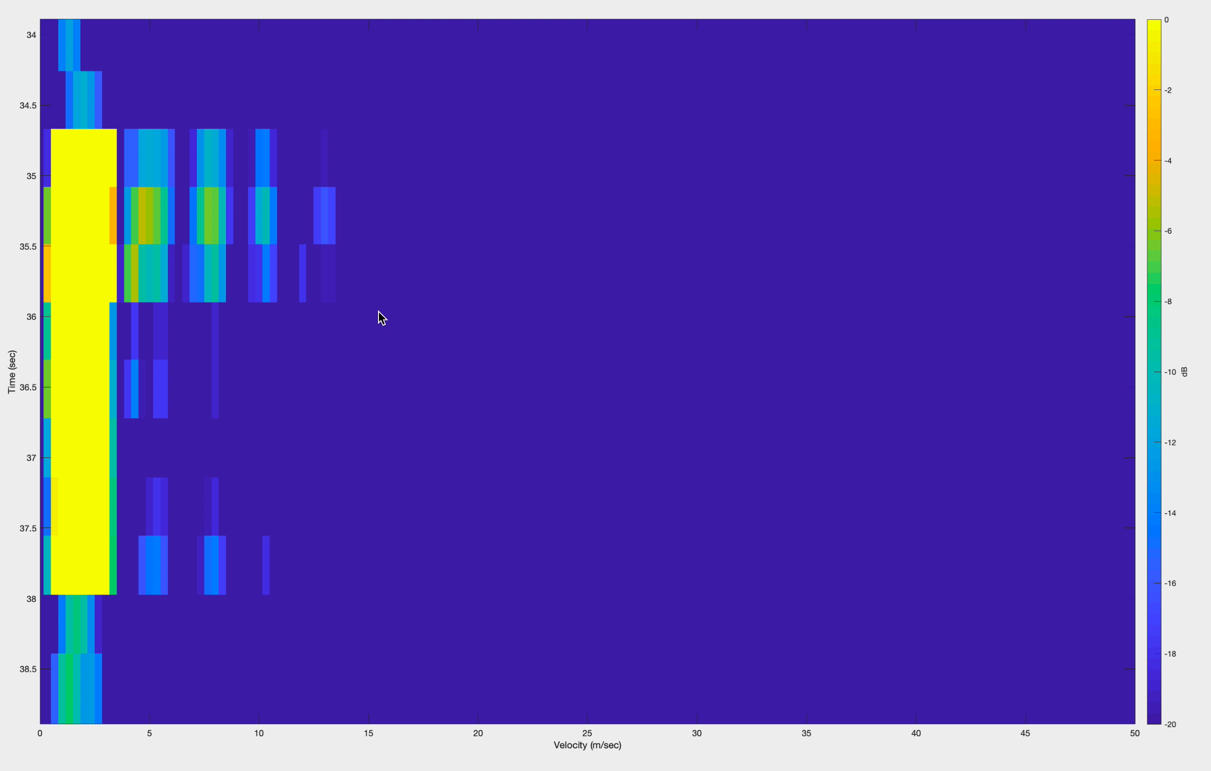
Realtime
Processing of 1024 samples each time

Slide 11
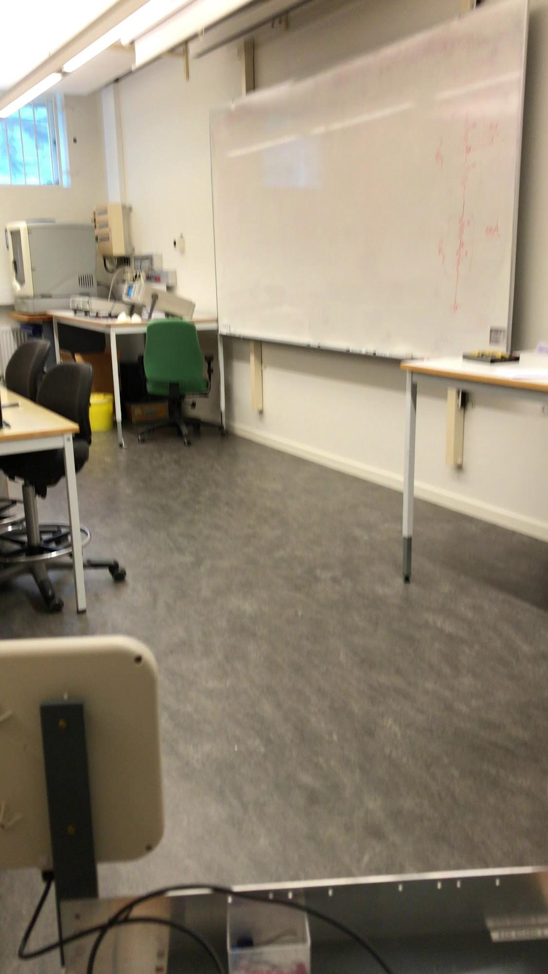
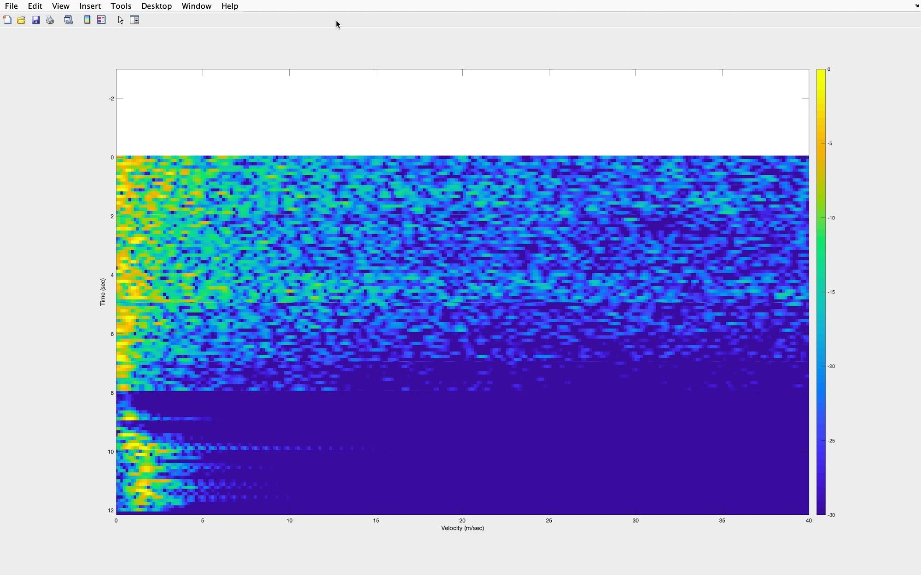
CW realtime 1sec

Slide 12
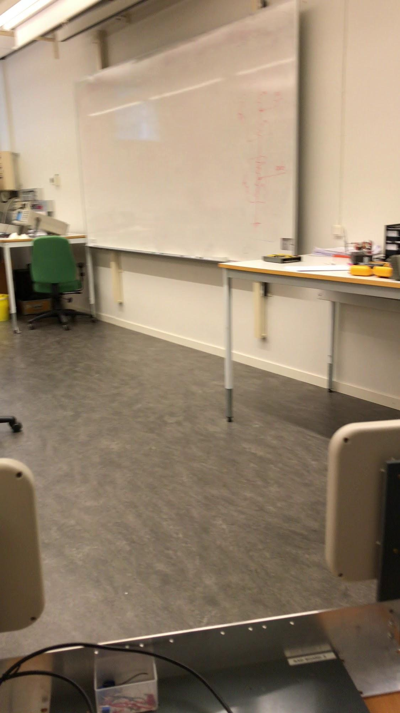
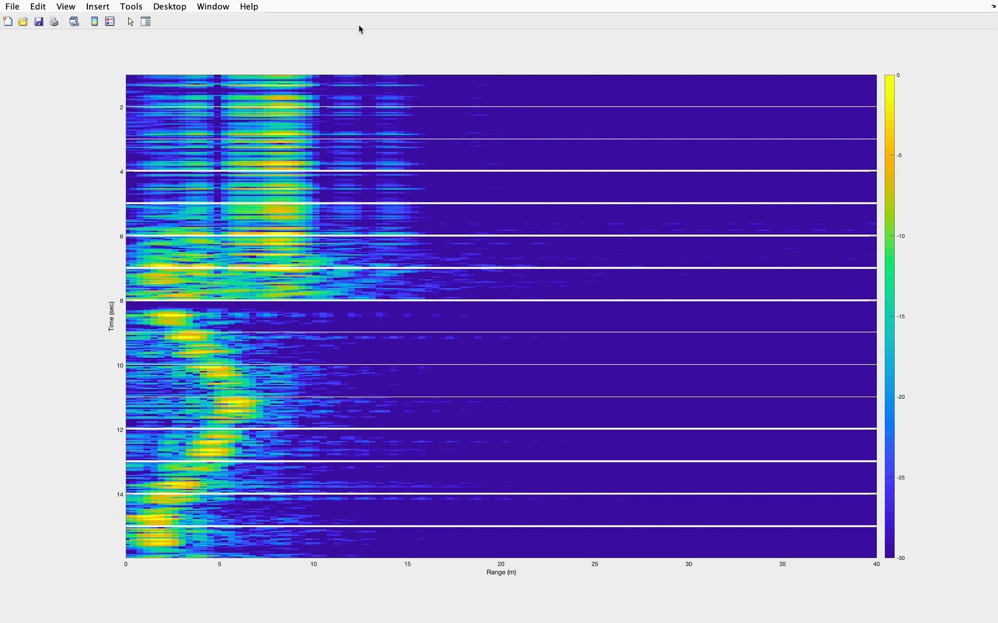
FMCW realtime 1sec

Slide 13
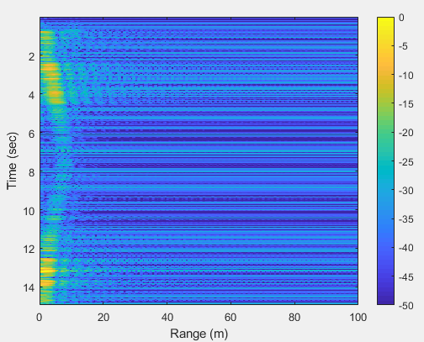
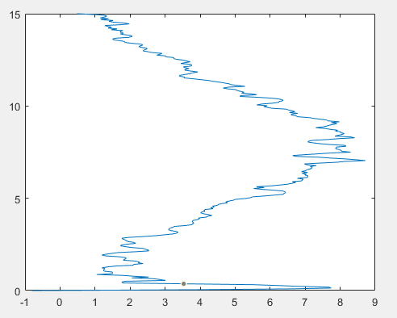
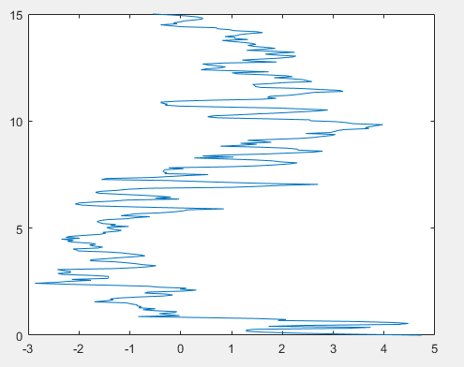
FMCW : Processing up/down chirp for range and velocity
FMCW range measurement
Recuparation of the range
Recuperation of the velocity

Slide 14
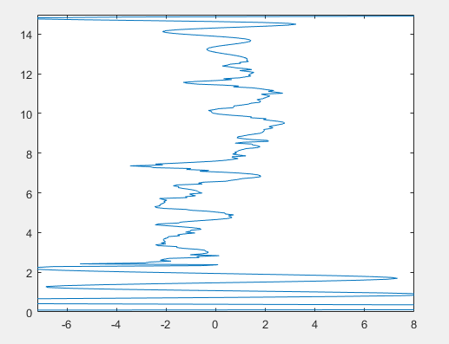
FMCW : Extracting Velocity from range
Two point finite method
Problem : Lot of noise, filtering needed
Velocity and direction with the sign

Slide 15
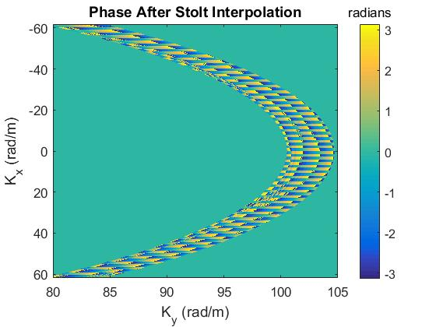
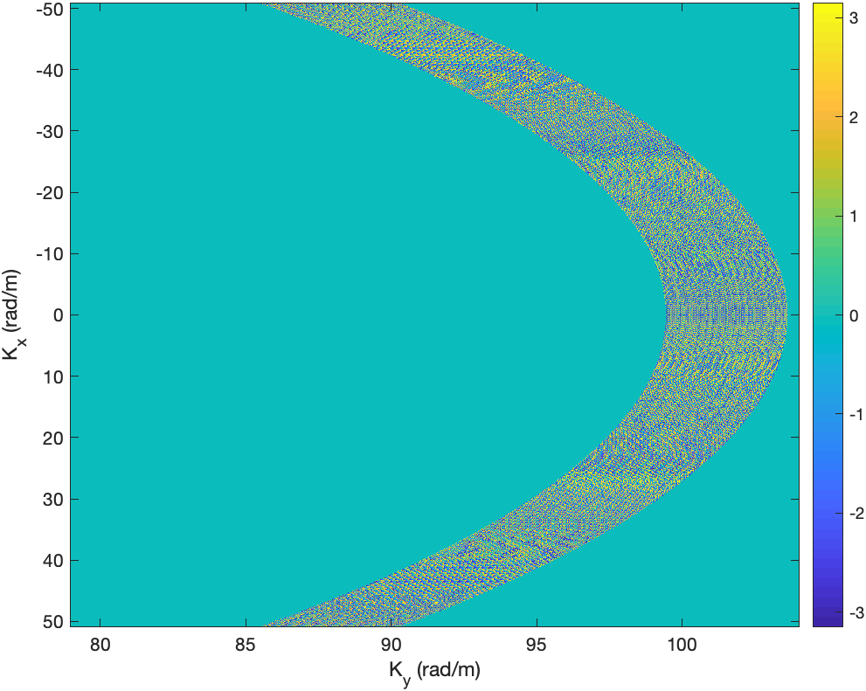
Matlab Simulation SAR Radar
Reference Image
Image obtained with our Matlab code

Slide 16
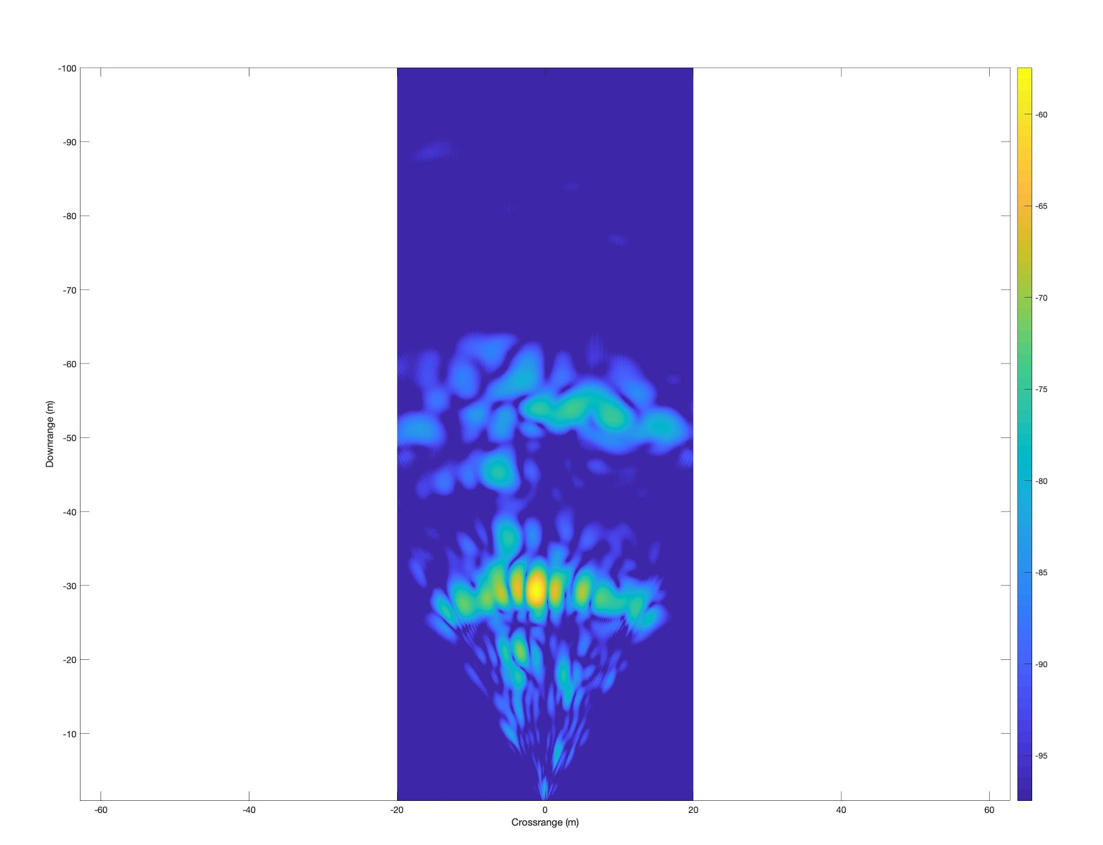
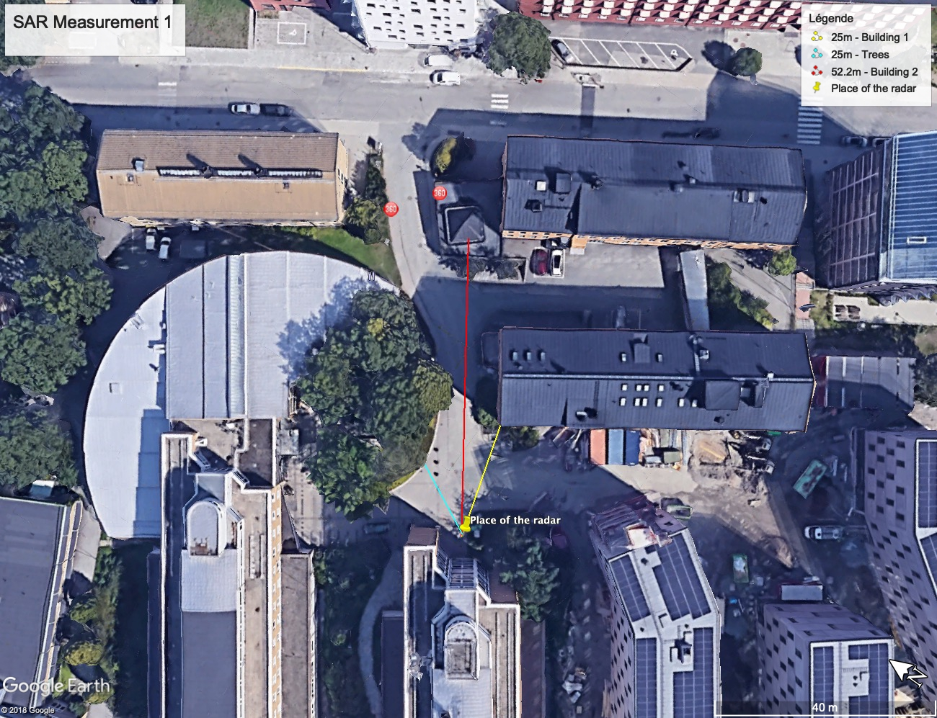
SAR measurements

Slide 17
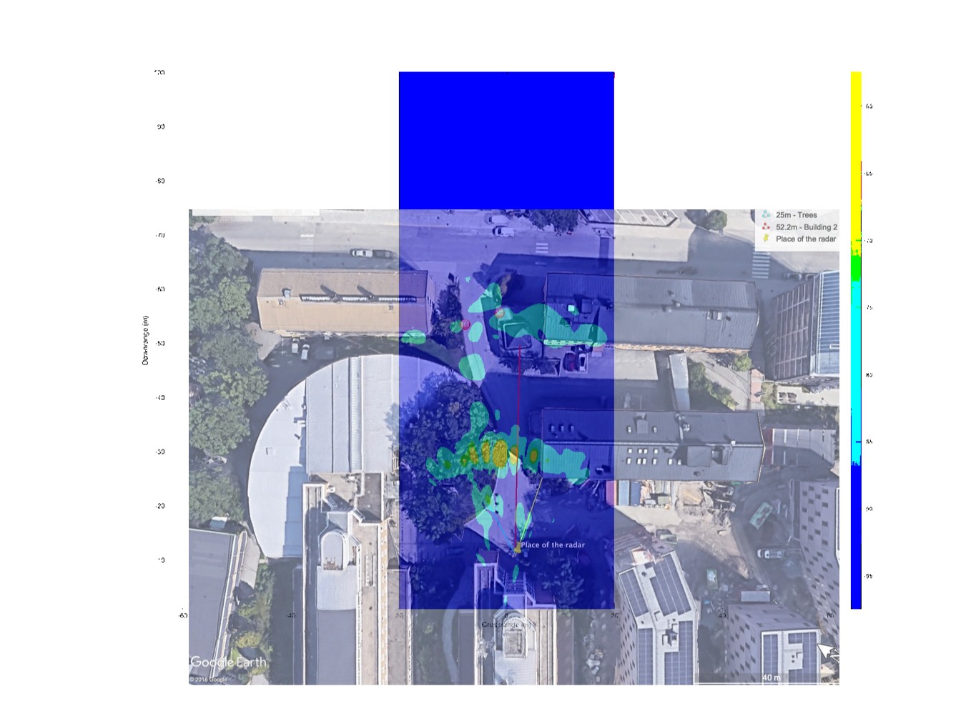
SAR measurements

Slide 18
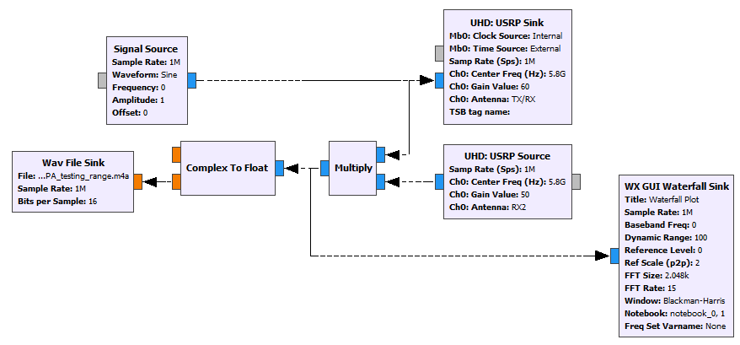
SDR : CW Flowchart

Slide 19
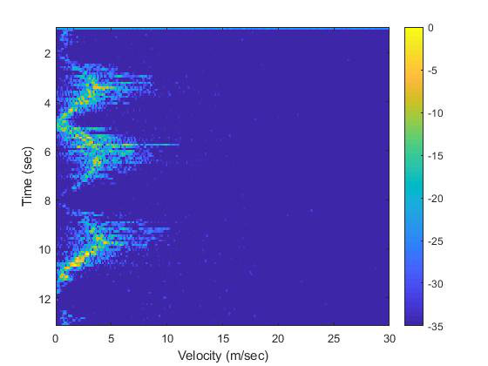
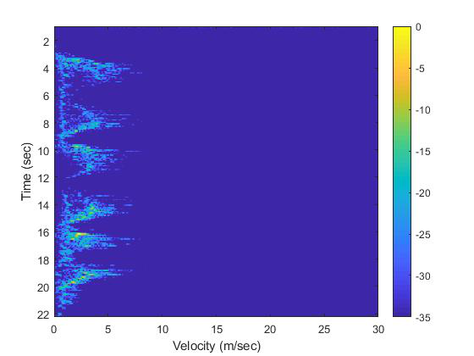
SDR : CW measurements

Slide 20
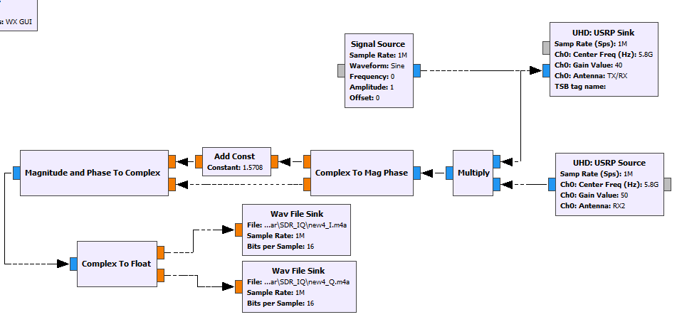
SDR : CW Flowchart for IQ demodulation

Slide 21
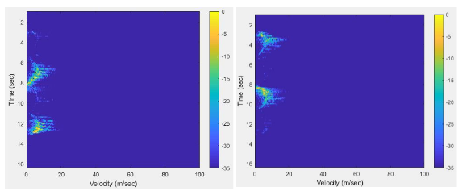
SDR : CW with IQ demodulation
measurements

Slide 22
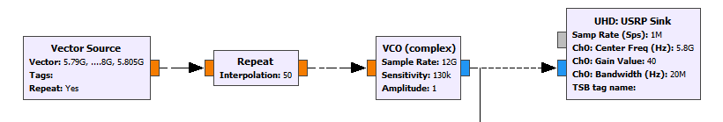
SDR : SFCW --Transmission
Transmitter flowgraph

Slide 23
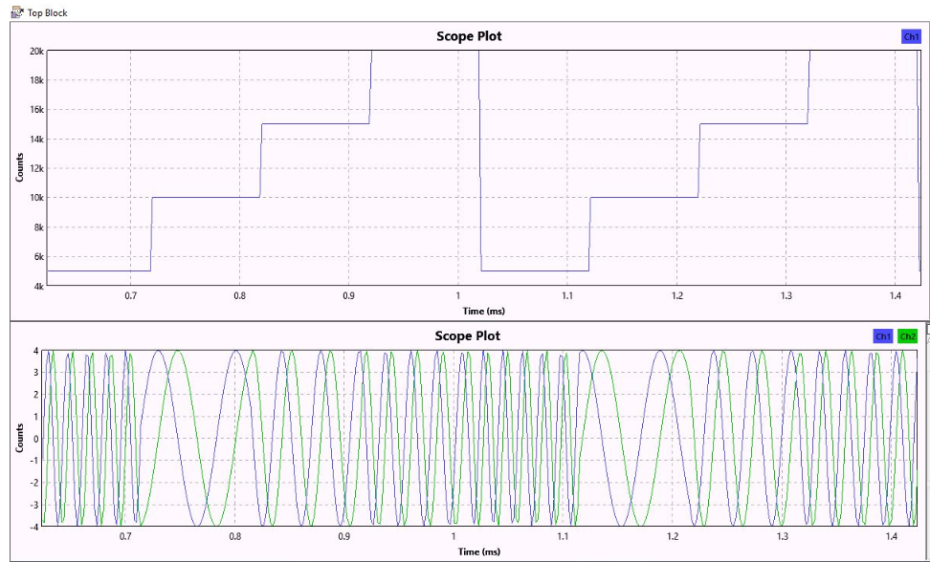
SDR : SFCW -- Transmitted signal
Generation of a stairway signal

Slide 24
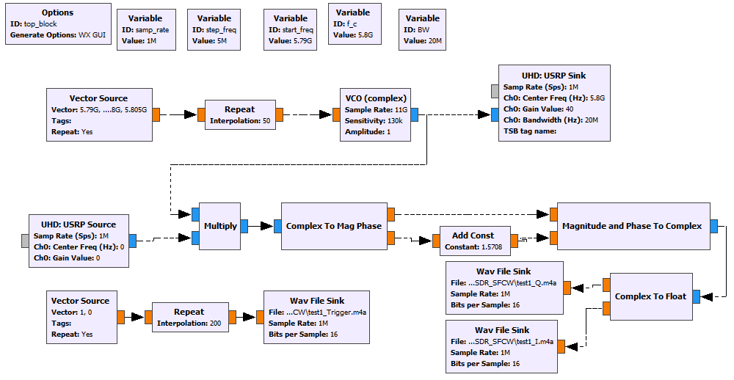
SDR : SFCW full flowchart

Slide 25
SDR : Range performance depending on output power
Gain of the output amplifier (dB) | Maximum range measured (m)
15 | 8
20 | 10
25 | 25
30 | 33
40 | 33
50 | 15

Slide 26
Thank you for your attention

